Slide 1
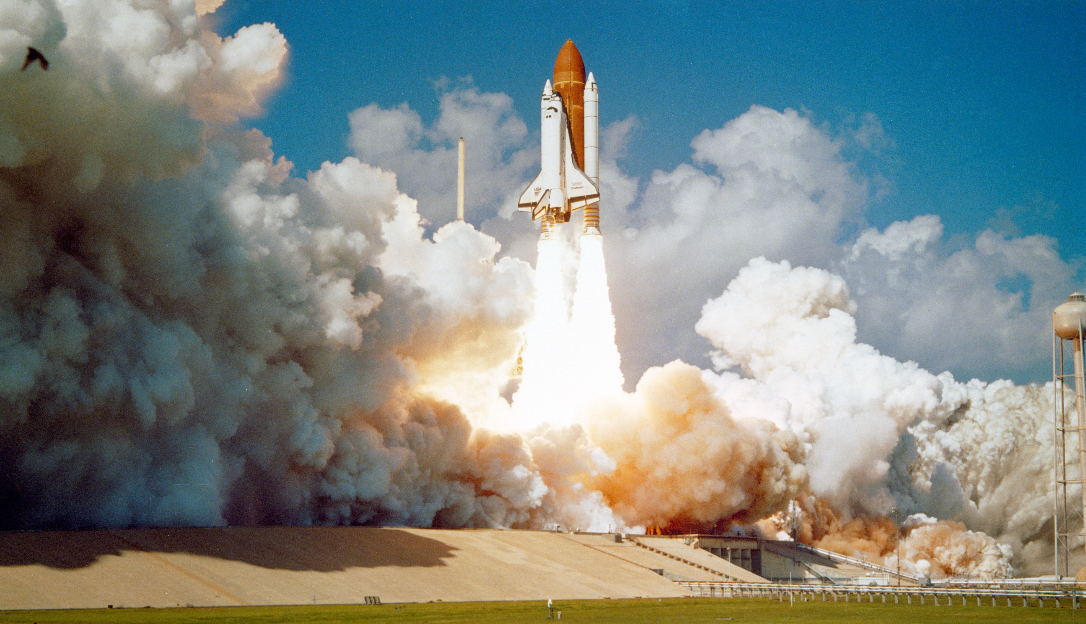
Data Science Capstone Project
SpaceX Falcon 9 First Stage Landing Prediction
Khadija Hammawa
26-08-2021

Slide 2

Outline
Executive Summary
Introduction
Methodology
Results
Conclusion
Appendix

Slide 3

Executive Summary
Summary of methodologies
Data Collection
Requests to the SpaceX API to acquire information on Falcon 9 rocket launches.
Web scraping Falcon 9 and Falcon Heavy launch records from Wikipedia.
Data Wrangling
Exploratory Data Analysis (EDA) to find patterns in SpaceX data related to the landing outcome of Falcon 9 first stage.
Convert landing outcomes into label for training supervised models.
Exploratory Data Analysis
Visualize detailed records for each launch site.
Select features that will be used in success prediction.
Interactive Visual Analytics and Dashboard
Build a dashboard to analyze launch records interactively with Plotly Dash.
Build an interactive map to analyze the launch site proximity with Folium.
Predictive Analysis
Split the data into training testing data and train different classification models (i.e., Logistic Regression, SVM, Decision Tree Classifier, and KNN)
Use GridSearchCV to determine best parameters
Calculate accuracy for each model to identify the most accurate model

Slide 4
Executive Summary
Summary of all results
Cape Canaveral Space Launch Complex 40 (CCAFS SLC 40) had the most launches
Most launches were geosynchronous orbit (GTO)
Success of first stage launches across all launch sites was 66.67%
Total payload mass carried by boosters launched by NASA (CRS) was 111,268 kg’s
Average payload mass carried by booster version F9 v1.1 was 2,534 kg
The first successful landing outcome in ground pad was achieved on December 22nd, 2015
12 Booster Versions were determined to have carried the maximum payload mass
When payload is over 10,000 kg's almost all the first stage landings are successful
ES-L1, GEO, HEO, and SSO Orbits had the highest success rates
Heavy payloads have a negative influence on GTO orbits and positive influence on GTO and Polar LEO (ISS) orbits
Success rate of launches have continually increased since 2013
Flight Number, Payload Mass, Orbit, Launch Site, Flights, Grid Fins, Reused Legs, Landing Pad, Block, and Reused Count were determined the be the features more important in predicting landing outcome
The Kennedy Space Center Launch Complex 39A was shown to have the highest success ratio for landing outcomes
All models performed the same with an accuracy score of 83.33%

Slide 5

Introduction
Project Background
The age of commercial space travel is no longer a far distant dream for humanity, instead, companies are now making space travel affordable for everyone. Companies such as Virgin Galactic, Rocket Lab, and Blue Origin are at the forefront of these suborbital spaceflight developments. One company that has had exceptional success is SpaceX. SpaceX advertises Falcon 9 rocket launches for 62 million USD while other companies charge upwards of 165 million USD per launch. These savings are largely due to SpaceX’s ability to reuse the first stage; the first stage is the first rocket engine to engage, providing the initial thrust to send the rocket skyward, this stage is typically bigger than the next stage(s) because it must transport not only itself but the rest of the stages.
Problem
In this capstone, we will predict if the Falcon 9 first stage will land successfully. Provided that we can determine whether the first stage will land, we can also calculate the cost of a launch.

Slide 6

Methodology

Slide 7
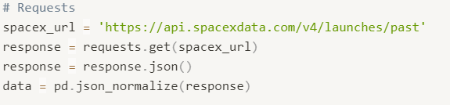
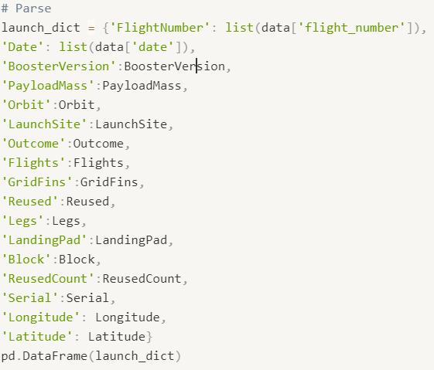
Data collection – SpaceX API
Request SpaceX launch data using the GET request
The response will return a json file which we will convert to a pandas DataFrame for easy data manipulation and analysis
Parse SpaceX launch data
Filter the DataFrame to only include Falcon 9 launches
Replace missing Payload Mass values with average Payload Mass
SpaceX API Notebook URL

Slide 8
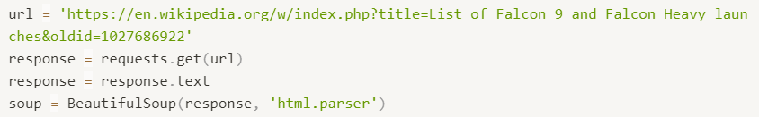
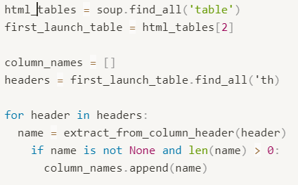
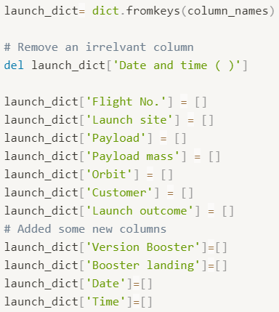
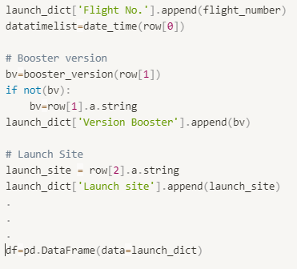
Data collection – Web scraping
Request the Falcon 9 Launch Wiki page from its URL
Extract all column/variable names from the HTML table header
iterate through the <th> elements and apply the provided extract_column_from_header() to extract column name one by one
Create a data frame by parsing the launch HTML tables
Initialize dictionary keys with empty lists
Append values to each dictionary key (code snippet only shows Booster Version and Launch Site, however, all keys were appended)
SpaceX Web scraping Notebook URL

Slide 9
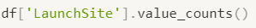
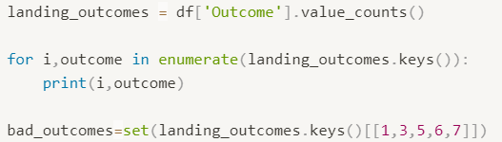
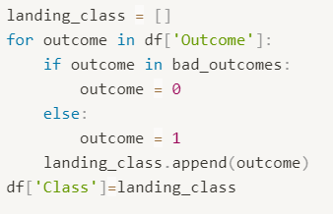
Data Wrangling
The number of launches at each site
This can help us determine which sites have the best outcomes for launches
The number and occurrence of each orbit
Calculating the number and occurrence of each orbit can help us identify which orbit launches are most successful
The number and occurrence of mission outcome per orbit type
Landing outcomes can be True or False (i.e., successful or not successful) and ASDS, RTLS, or Ocean represent ground pad, drone ship, or ocean landing, respectively. By understanding these variables, we can create a set of bad outcomes where the second stage did not land successfully and where this landing occurred.
Create a landing outcome label from Outcome column
Calculate the success rate across all launch sites
Data Wrangling Notebook URL

Slide 10
EDA with data visualization
For our EDA with data visualizations six plots were charted:
In this first plot we created a scatter point chart that looked at the relationship between Flight Number and Launch Site. The points on the graph were either blue or orange corresponding to their class; Class 0 = unsuccessful and Class 1 = successful launch, respectively.
In our second chart we also created a scatter point graph to illustrate the relationship between Payload and Launch site, similarly, points were color-coded according to their class. This graph highlights the Launch sites which appeared to have the most successful launches of unsuccessful launches as well as the typical mass of the payload launched.
Third, we created a bar chart for success rate of each orbit. The bar chart easily identifies which orbit’s had high success rates.
Next, we wanted to see if there was any relationship between Flight Number and Orbit type, therefore, we created a scatter point plot to demonstrate this.
Similarly, we also created a scatter point chart to plot the relationship between Payload Mass and Orbit type. This chart provides a clear visualization of how a Payload’s Mass can either positively or negatively influence a certain orbit type.
Lastly, we created a line chart to demonstrate the launch success yearly trend. In this graph, average success rate was the dependent variable while the years 2010 to 2017 were plotted as the independent variable.
SpaceX EDA with Pandas & Matplotlib URL

Slide 11
EDA with SQL
Query 1: The names of the unique launch sites.
Query 2: Five records where launch sites begin with the string 'CCA’.
CCA = Cape Canaveral Space Launch Complex
Query 3: The total payload mass carried by boosters launched by NASA (CRS).
Query 4: Average payload mass carried by booster version F9 v1.1.
Query 5: The date when the first successful landing outcome in ground pad was achieved.
Query 6: The names of the boosters which have success in drone ship and have payload mass greater than 4000 but less than 6000.
Query 7: The total number of successful and failure mission outcomes
Query 8: The names of the booster versions which have carried the maximum payload mass.
Query 9: List of failed landing outcomes in drone ship, their booster versions, and launch site names for the in year 2015.
Query 10: The occurrence of each landing outcomes (e.g., Failure (drone ship) or Success (ground pad) between June 4th, 2010, to March 20th, 2017, in descending order
SpaceX EDA with SQL

Slide 12
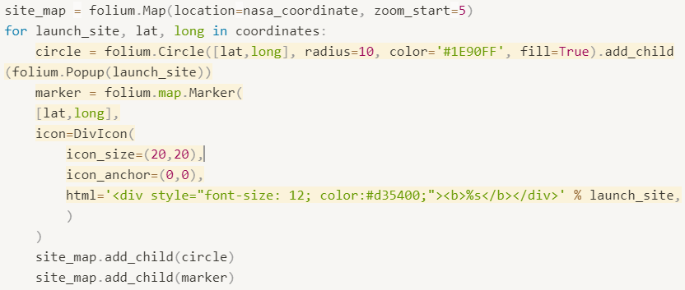
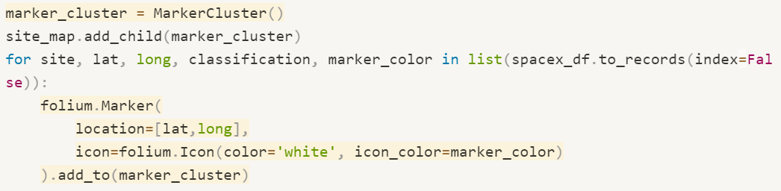
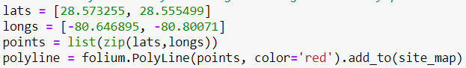
Build an interactive map with Folium
The first map objects we added was a circle for each launch site and a marker to label the launch site.
Next, we created a marker cluster object to illustrate the launch outcomes for each site, thus visualizing which sites have high success rates.
Finally, we added a Polyline object to show the distance between launch site KSC LC-39A and the Florida East Coast Railway
Interactive map with Folium Notebook URL

Slide 13
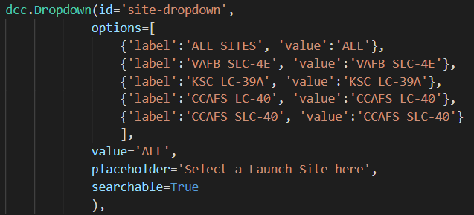
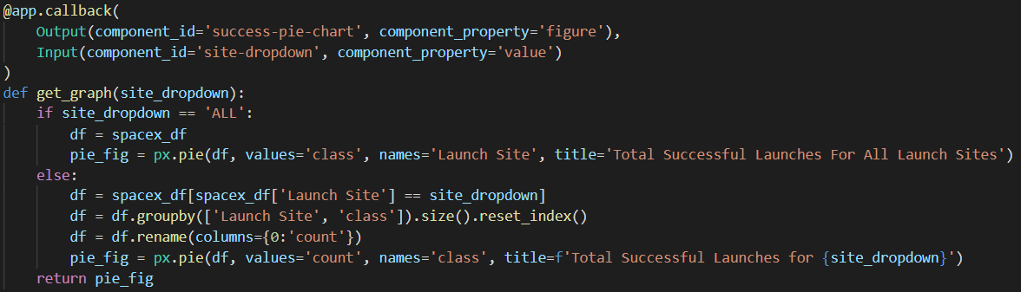
Build a Dashboard with Plotly Dash
For our dashboard we created two types of graphs. First, a pie chart displaying the success/failures of each launch site including the successes for ALL launch sites. This type of chart provided an easy way of examining which site(s) had the best success ratio.
Plotly Dashboard URL

Slide 14
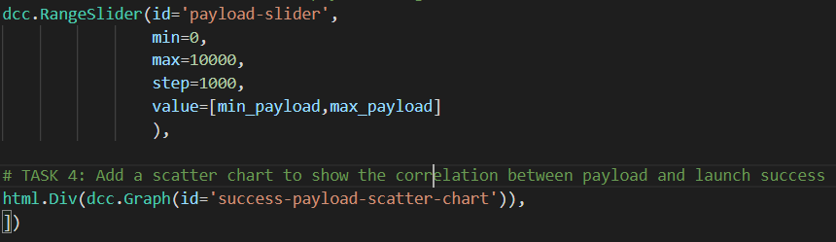
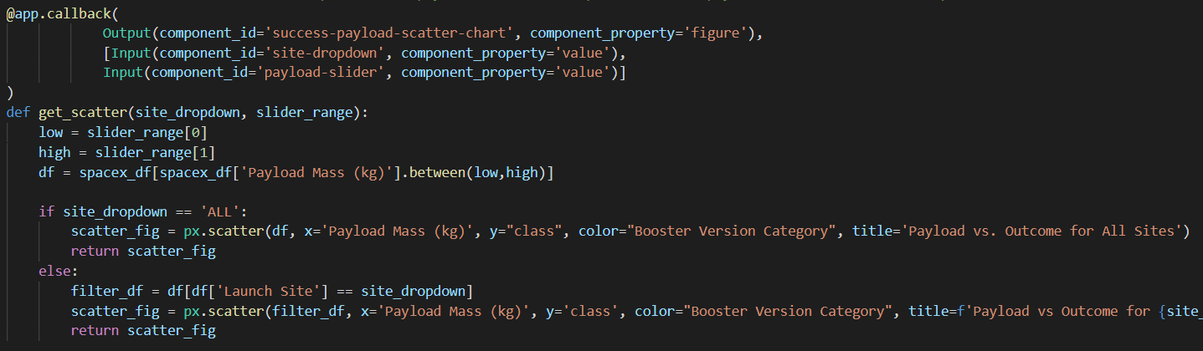
Build a Dashboard with Plotly Dash (continued..)
Next, we produced a scatter plot in which we looked at the relationship between payload mass and class. In this plot we can easily identify different success rates based on payload mass AND how this might be related to the Booster Version
Plotly Dashboard URL

Slide 15
Predictive analysis (Classification)
The cleaned data was fitted onto four classification models:
Logistic Regression: Logistic regression is analogous to linear regression but tries to predict a categorical or discrete target field instead of a numeric one. The goal of logistic regression is to build a model to predict the class of each launch and the probability of each sample belonging to a class.
Support Vector Machine (SVM): SVM is a supervised algorithm that can classify cases by finding a separator the SVM algorithm outputs an optimal hyperplane that categorizes new examples. SVM has several advantages such as good accuracy in high dimensional spaces.
Decision Tree Classifier: Decision trees create a tree-like model by testing an attribute and branching the cases based on the result of the test. The underlying principle in creating decision tree’s is determining the information gain—the information that can increase the level of certainty after splitting. In other words, when creating decision trees, we are looking for trees that have the lowest entropy (randomness) in their nodes.
K-Nearest Neighbors (KNN): KNN is an algorithm that classifies cases data points based on their similarity to other cases. data points that are near each other are said to be neighbors. In this model, K is defined as the number of neighbors the model must consider when classifying data points.
To find the best hyper-parameters for each model we used GridSearchCV. GridSearchCV is a library function that is a member of sklearn's model_selection package. It helps to loop through predefined hyperparameters and fit your estimator (model) on your training set. Thus, we can easily select the optimal parameters for your model
Finally, we calculated the accuracy score for each model to determine which model performed best.
SpaceX Classification Analysis Notebook

Slide 16
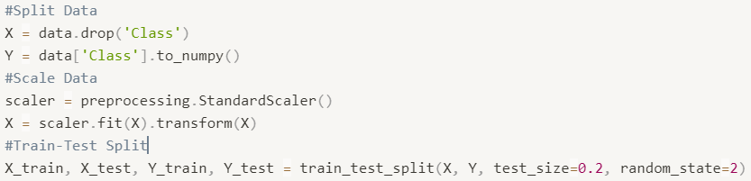
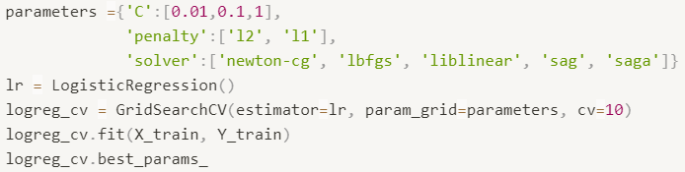
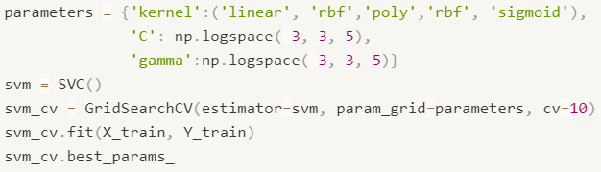
Predictive analysis (continued..)
Split DataFrame, then scale data and perform a train-test-split
Create a logistic regression object then create a GridSearchCV object. Fit the object to find the best parameters from the dictionary parameters
Create SVM object then create a GridSearchCV object svm_cv with cv - 10. Fit the object to find the best parameters from the dictionary parameters.
SpaceX Classification Analysis Notebook

Slide 17
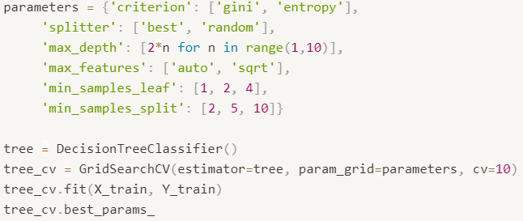
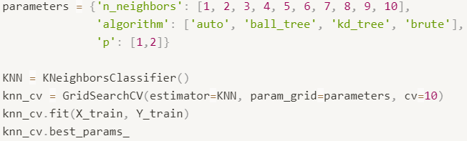
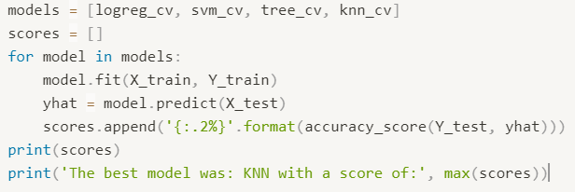
Predictive analysis (continued..)
Create a decision tree classifier object then create a GridSearchCV object tree_cv with cv = 10. Fit the object to find the best parameters from the dictionary parameters
Create KNN object then create a GridSearchCV object knn_cv with cv = 10. Fit the object to find the best parameters from the dictionary parameters
Find best performing model
SpaceX Classification Analysis Notebook

Slide 18

Results

Slide 19
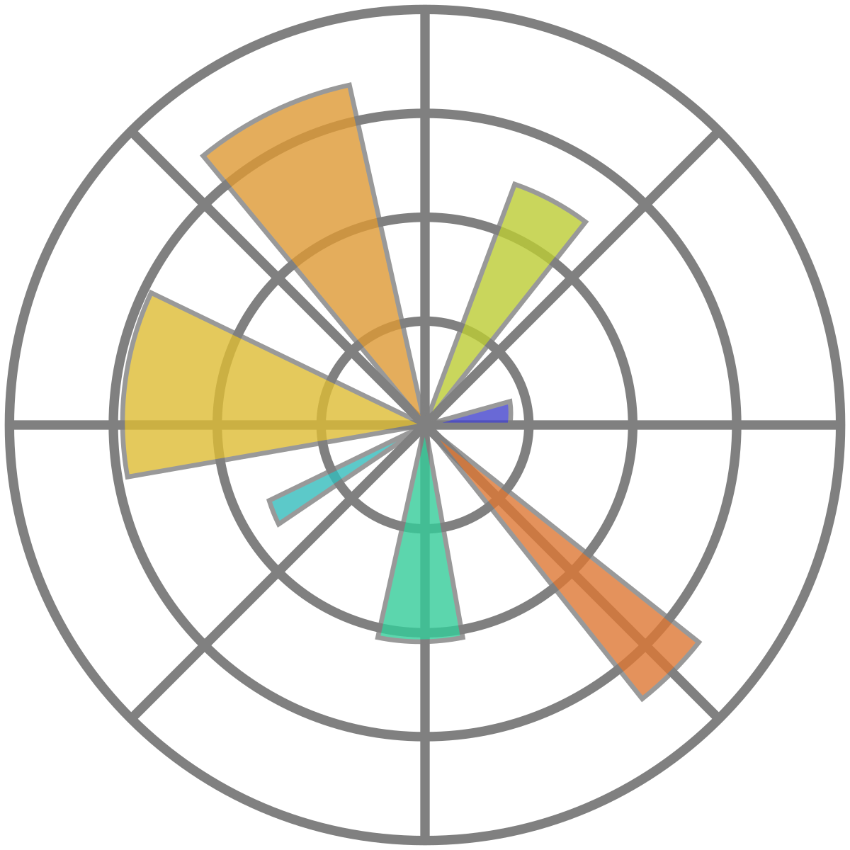
EDA with Visualization

Slide 20
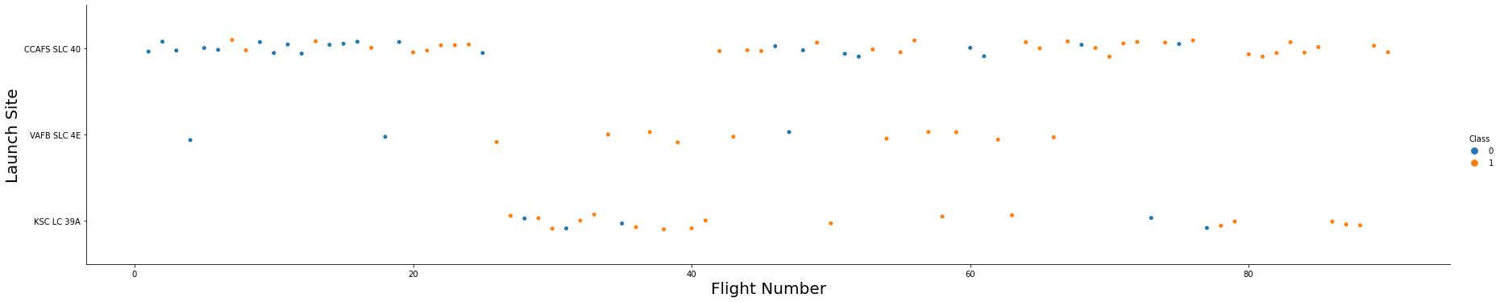
Flight Number vs. Launch Site
This scatter point plots displays the relationship between flight number and launch site. Here, we see that the launch site is our dependent variable while the points on the graph are color-coded according to a launches class. Class 0 represents unsuccessful launches while Class 1 are successful launches.
The launch sites are as follows:
CCAFS SLC-40: Cape Canaveral Space Launch Complex 40
VAFB SLC-4E: Vandenberg AFB Space Launch Complex 4
KSC LC 39A: Kennedy Space Center Launch Complex 39A

Slide 21
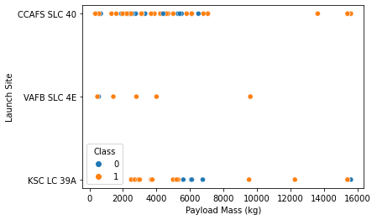
Payload vs. Launch Site
In this plot we can see the relationship between Payload Mass and Launch Site. Additionally, the points are the scatter plot are colored according to their class 0 are unsuccessful launches and class 1 are successful launches.
The launch sites are as follows:
CCAFS SLC-40 is Cape Canaveral Space Launch Complex 40
VAFB SLC-4E is Vandenberg AFB Space Launch Complex 4
KSC LC 39A is
Kennedy Space Center Launch Complex 39A
The payload is the load carried by an aircraft or spacecraft consisting of things (such as passengers or instruments) necessary to the purpose of the flight

Slide 22
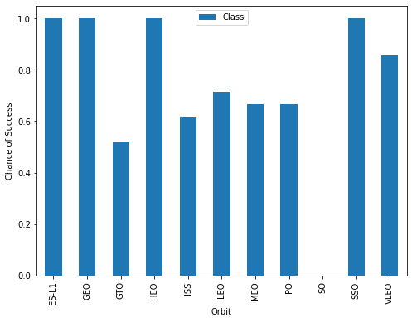
Success rate vs. Orbit type
This bar chart looks at the rate of success for each orbit type.
We can see 11 different orbit types:
LEO: Low Earth orbit (LEO)is an Earth-centered orbit with an altitude of 2,000 km (1,200 mi) or less (approximately one-third of the radius of Earth.
VLEO: Very Low Earth Orbits (VLEO) can be defined as the orbits with a mean altitude below 450 km
GTO A geosynchronous orbit is a high Earth orbit that allows satellites to match Earth's rotation. Located at 22,236 miles (35,786 kilometers) above Earth's equator.
SSO (or SO): It is a Sun-synchronous orbit also called a Heli synchronous orbit is a nearly polar orbit around a planet..
ES-L1 :At the Lagrange points the gravitational forces of the two large bodies cancel out in such a way that a small object placed in orbit there is in equilibrium relative to the center of mass of the large bodies. L1 is one such point between the sun and the earth \[5] .
HEO A highly elliptical orbit, is an elliptic orbit with high eccentricity, usually referring to one around Earth.
ISS A modular space station (habitable artificial satellite) in low Earth orbit.
MEO Geocentric orbits ranging in altitude from 2,000 km (1,200 mi) to just below geosynchronous orbit at 35,786 kilometers (22,236 mi).
HEO Geocentric orbits above the altitude of geosynchronous orbit (35,786 km or 22,236 mi) \[9]
GEO It is a circular geosynchronous orbit 35,786 kilometers (22,236 miles) above Earth's equator and following the direction of Earth's rotation.
PO It is one type of satellites in which a satellite passes above or nearly above both poles of the body being orbited.

Slide 23
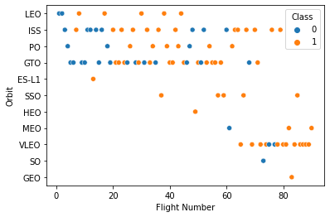
Flight Number vs. Orbit type
Rather than looking at success rate for each orbit type in this graph we plot the points of the scatter plot according to their class. Similarly, flight number is plotted on the x-axis as the independent variable. This graph also shows an alternate way of looking at which orbit types are most successful.

Slide 24
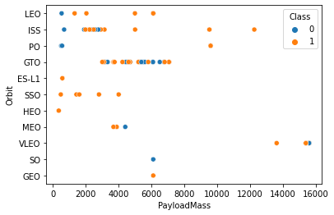
Payload vs. Orbit type
Similarly, we can plot the Payload vs. Orbit scatter point charts to reveal the relationship between Payload and Orbit type. Since our points are labelled according to their class, we can also see which orbit types tend to have successful launches and at what payload mass.
Payload mass is shown in kilograms

Slide 25
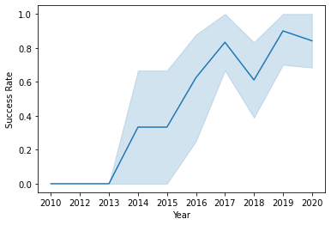
Launch success yearly trend
We can also display launch success across several years. Rather than drilling down on individual launch sites this graph displays the average success rate of launches across all sites per year. In addition, this line chart also contains shaded areas that repersent confidence intervals—simply put, a confidence interval is the mean of your estimate plus and minus the variation in that estimate

Slide 26

EDA with SQL

Slide 27
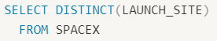
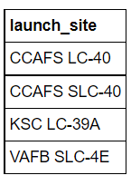
All launch site names
Query execution:
Results: names of all four launch sites. There are only three launch sites in this dataset as Space Launch Complex 40 (SLC-40), was previously Launch Complex 40 (LC-40)

Slide 28
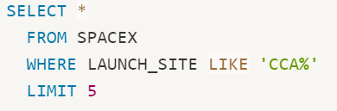
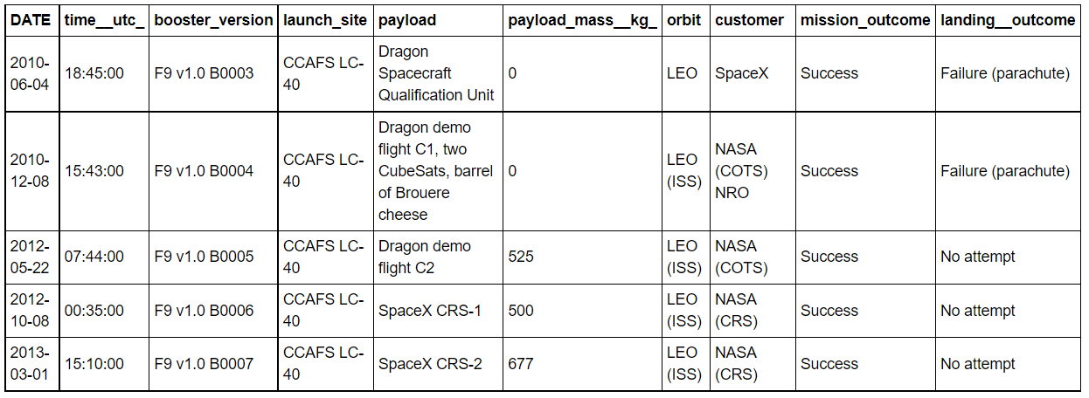
Launch site names begin with `CCA`
Query Execution:
Result: list of five launch records that occurred at Space Launch Complex 40/Launch Complex 40

Slide 29
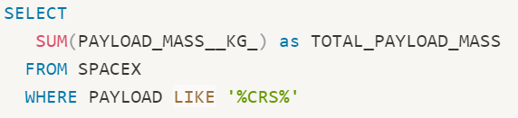
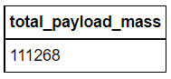
Total payload mass
Query Execution:
Result: The total mass in kilograms for all payloads carried by NASA boosters (i.e., ‘CRS’)

Slide 30
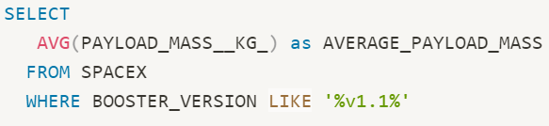
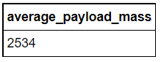
Average payload mass by F9 v1.1
Query execution:
Result: The average payload mass in kilograms carried by the Falcon 9 booster version 1.1

Slide 31
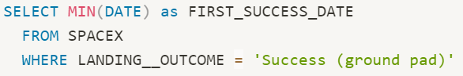
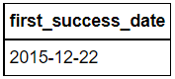
First successful ground landing date
Query execution:
Result: The date of the first successful landing outcome in ground pad on December 22nd, 2015

Slide 32
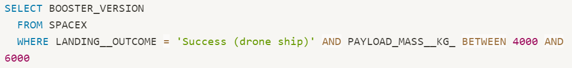
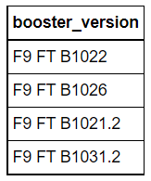
Successful drone ship landing with payload between 4000 and 6000
Query execution:
Result: List of all boosters which have a payload mass between 4000-6000kg’s which have landed successfully in drone ship

Slide 33
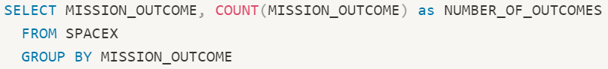
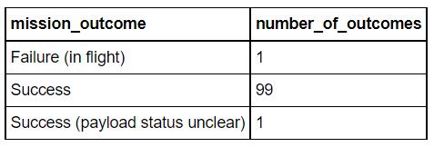
Total number of successful and failure mission outcomes
Query execution:
Result: The total number of occurrences for each mission outcome

Slide 34
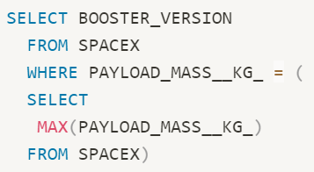
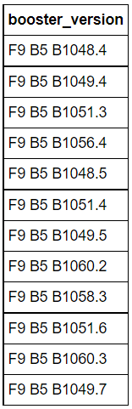
Boosters carried maximum payload
Query execution:
Result: A list of boosters that have carried payloads with maximum payload mass

Slide 35
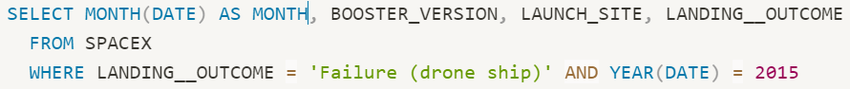
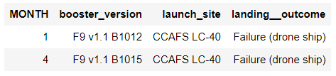
2015 launch records
Query execution:
Result: The records of failed landing outcomes in drone ship along with their, booster versions, and launch site for the months in year 2015

Slide 36
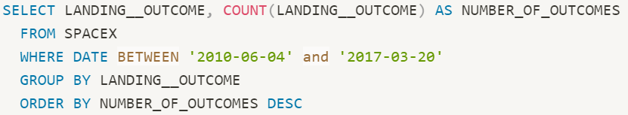
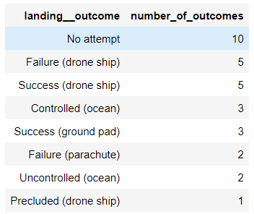
Rank success count between 2010-06-04 and 2017-03-20
Query execution:
Result: The number of successful landing outcomes between June 4th, 2010, to March 20th, 2017, in descending order

Slide 37

Interactive map with Folium

Slide 38


Folium map with all launch sites marked
Note that CCFAS SLC-40 and CCFAS LC-40 are the same launch sites

Slide 39


Folium map with the success/failed launches for each site
CCAFS LC-40/CCAFS SLC-40
Green = successful launch
Red = unsuccessful launch

Slide 40


Folium map with the success/failed launches for each site (continued…)
KSC LC-39A
VAFB SLC-4E
Green = successful launch
Red = unsuccessful launch

Slide 41

Map illustrating the distances between KSC LC-39A and the Florida East Coast Railway
The distance between FECR and KSC LC-39A was calculated to be 15.15km

Slide 42

Build a Dashboard with Plotly Dash

Slide 43

Pie Chart of Launches for All Sites
This pie chart displays the number of successful launches for each site. Such that KSC LC-39A is shown to have the most successful while CCAFS SLC-40 has had the least success.

Slide 44

Pie Chart of KSC LC-39A Launches
In this pie chart we focus on launch site KSC LC-39A since this site had the highest ratio of successes. The blue are repersents the succesful class (i.e. class 1) while the red area is the unsuccessful class (i.e. class 0)

Slide 45

Scatter Plot of Payload vs Launch Outcome
The first chart displays the launch outcomes for payloads weigh between 1000 – 5000kg’s. In addition, the launch outcomes are further cateogrized by their booster version

Slide 46

Scatter Plot of Payload vs Launch Outcome (cont..)
In this chart we display the same information but for payloads weighing between 5000 – 10,000 kg’s

Slide 47

Predictive Analysis (Classification)

Slide 48

Classification Accuracy
All models performed equally with an accuracy score of 0.8333 or 83.33%

Slide 49

Confusion Matrix
When examining the confusion matrix, we can see that the True labels are on the y-axis while predicted labels are on the x-axis. True labels represent the actual labels in the dataset (i.e., y-test) and as the name suggests predicted labels are those predicted from our model (determined from X_test). Furthermore, if we look closer, we can see that our model performed very well ,however, it shows some difficulty when trying to predict when the Falcon 9 landed when it in fact did not land. This type of error is called a false positive.

Slide 50

CONCLUSION
The purpose of this project was to examine the relationship between several rocket launch features and how they potentially impact the landing outcome of Falcon 9 first stage. Using various ML model’s, we were able to determine the landing outcome with 83% accuracy.
The results from this project can help those who are interested in increasing their chances of producing landing outcomes with the best success.
Finally, by determining whether the first stage will land successfully, findings from this project will help relevant stakeholders and companies to compete with SpaceX.

Slide 51

Appendix

Slide 52


Feature Engineering
Create dummy variables for categorical columns
Cast all numeric columns to ‘float64’

Slide 53

Folium Maps
Add Mouse Position to get the coordinate (Lat, Long) for a mouse over on the map

Slide 54


Finding the Best Model
Create a dictionary containing model names and their accuracy score
Convert the dictionary to a DataFrame to easily plot
Plot model names on the x-axis and accuracy score on the y-axis

